Slide 1
What Kind Of Media Institution Might Distribute Your Media Product And Why?

Slide 2
What Companies Would Distribute My Film?

Slide 3
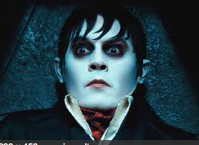
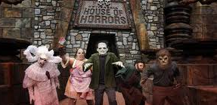
Warner Bros
Warner Bros have distributed films such as ‘House Of Horrors’ ‘Dark Shadows’ and ‘Final Destination 5’. This company could distribute my film as they have experience with other horror films.
Dark Shadows
House Of Horrors
Final Destination 5

Slide 4
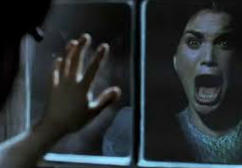
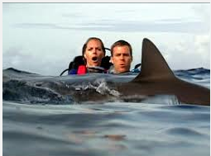
LionsGate
Lionsgate has distributed films like ‘The Woman In Black’ ‘Open Water’ and ‘Saw’. This company has produced a few horror moves including the famous ‘Saw’. This could be an option however they do concentrate on thriller horror whereas my films is Yurei horror. Below are some images from each of the films mentioned above.
The Woman In Black
Saw
Open Water

Slide 5
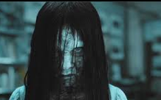
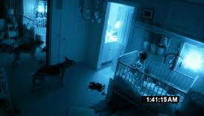
DreamWorks
DreamWorks have distributed films like ‘The Ring’ ‘Fright Night’ ‘The Haunting’ and ‘Paranormal Activity’. ‘The Ring’ is Yurei horror. Dreamworks would be interested in my film as it is very similar to ‘The Ring’. The above films are all horror. The film Paranormal Activity has many enigmas. For example the victim hears a noise and the audience don’t know where it is coming from. My film has enigmas in it like when Leila falls down the stairs. Dreamworks have distributed films similar to my one.
The Ring
Paranormal Activity
Fright Night

Slide 6
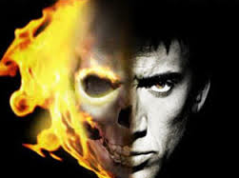
Columbia
Columbia is owned by SONY pictures. They have distributed films like ‘The Grudge 1&2’ ‘Ghost Rider’ and ‘Zombie Land’. This company have produced The Grudge, this is a Yurei horror films – the same genre as my film. This company seem to be interested in Yurei horror movies which makes me feel like they would be interested in producing my film.
Ghost Rider
Zombie Land
The Grudge

Slide 7
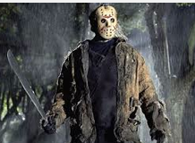
Paramount Pictures
Paramount pictures have distributed films like ‘Paranormal Activity’ ‘Friday 13th’ and ‘The Devil Inside’. These films are all supernatural horror. However my film is Yurei horror. Although this company have produced horror movies they don’t seem to be interested in Yurei horror films.
Paranormal Activity
The Devil Inside Me
Friday 13th

Slide 8
Independent Film Companies
Fear Film Independent Production is a company that distributes only horror movies on a low budget. They are based in Orlando, Florida.
Very Scary Productions is a company that only distributes horror movies also on a low budget. They are based in New York.
Cabiria is a company based in Europe distributing and producing different genres of films.

Slide 9
Similar Films to Mine
Dreamworks distributed the film ‘The Ring’, my film is very similar to this one therefore there would be a high possibility of Dreamworks distributing my film. However ‘The Ring’ had a budget of 48,000,000 dollars. My film has a low budget so I doubt Dreamworks would show interest in distributing my film.
However an independent film company called Fear Film, would be an ideal company to distribute my film. They focus on horror films with a low budget. My film is both of these. Fear Film have produced films like ‘Truth Or Dare Syndrome’ and ‘Creepy Crawly’. They have not yet produced a Yurei horror movie which is why I think they would be interested in my film.

Slide 11
Below is a link to view the trailer for ‘Creepy Crawly’

Slide 12
Advertising My Film
Advertising your film is selling it. You are trying to get your product to the people and persuade them to watch or buy it. Some advertising techniques like a TV advert may be very expensive but in the long run it can help your product a lot.
Types of advertising for my film: -Adverts before film starts at cinema -Radio -Word Of Mouth -Posters -Soundtrack (Like James Bond- Skyfall) -Advertisements on web pages at the side
However these advertising techniques can be a lot of money. Some free ways of advertising would be: -Facebook -YouTube -Twitter -On my blog -Word of mouth

Slide 13
Word of mouth is one of the biggest types of advertising because everyone can do it. For example, If I went to watch a film at the cinema and I didn’t like it I would tell everyone how bad it was with no good points. However if I really enjoyed the film I would tell people how good it was. Studies show that more people complain and talk about bad films than they say good things about good films.
Adverts before a film starts at the cinema can also be a good advertising technique because you are sitting in your chair with nothing to do but look at the big screen so what ever appears on the screen you will watch.
Advertising on social networking sites like Facebook and Twitter are easy and free ways to get your film to the audience. On Facebook all people have to do is share the film on their page and a whole new group of people will see it and so on.

Slide 14
Examples Of Marketing Campaigns

