Slide 1
Technologies
What have you learnt about technologies from the process of constructing this product?

Slide 2
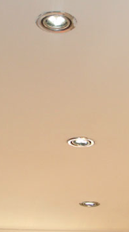
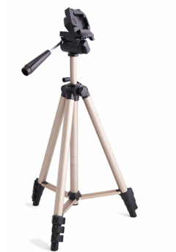
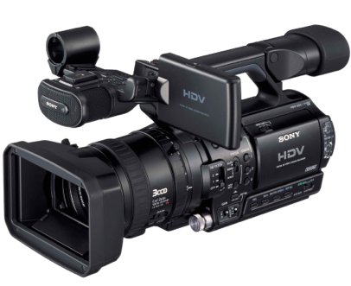
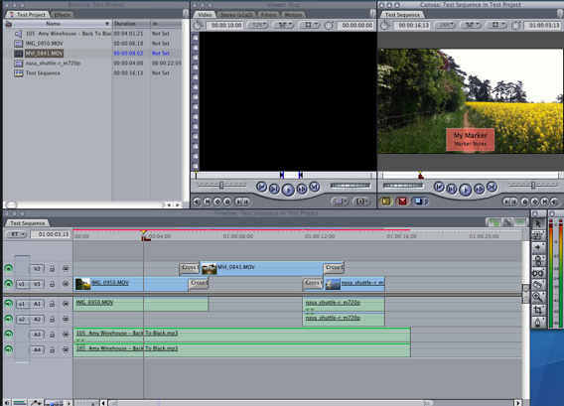
Technologies used:

Slide 3
CAMERA
The camera I used to film was the Canon 50D.
When making the film it was the first time I had ever used a proper filming camera. At first I found it hard to figure what button was what but after a little playing around with different focuses and effects I worked out how to use it. It was also hard to get the camera in focus at times. When first switching it on and then when we changed rooms the lighting was different so we had to wait for the focus of the camera to adjust. When we filmed the laptop screen to show Facebook there was some distortion in the focus. Therefore we had to re shoot this shot so it was in focus and clearer for the audience.
Our camera allowed my group to look back over the footage once filming it without over righting shots. I found this helpful because we were able to see if we had filmed enough before moving onto the next shot. A mistake that I made was not filming a shot long enough. I shot some speech for four seconds and then coming to edit it there was not enough footage to use it so we re shot the speech. The camera was rolling five seconds before and after the speech. I learnt that it’s better to have too much footage than not enough.

Slide 4
TRIPOD
When using the tripod it made filming much easier. If I held the camera with my hand and did a pan or moved with it, the footage would be bad quality and shaky. It would be out of focus. However if you use a tripod, still footage is produced. You can use the handle to slowly move the camera around.
I found using the tripod very easy and you can make it move to different heights for different shots. This was very helpful as when I shot Olivia from outside I used the tripod on the highest it could go whereas when I shot the laptop screen it was on the lowest it could go.

Slide 5
LIGHTING
In our location the house had lights similar to the above picture. Natural lighting that came through the window was also used. In the kitchen when filming the mug of tea, the toaster and eggs ceiling spot lights were used.
At times when using these ceiling spot lights it was hard to film with them because the picture quality didn’t come as good. So I had to play around with different angles in regards to where the spot lights were. When filming the mug of tea I had to turn on one side of the rooms spot lights and leave the other half off because it looked too bright on camera.

Slide 6
FINAL CUT PRO
When I finished filming, the editor used final cut pro to edit the film. Myself and the director assisted him so we knew how the program also worked.
The editor found the program ok to work with although found difficulty with inserting text with the correct font. To overcome this problem we used another program called Vegas Pro to do this. We understood this program a little clearer than final cut pro.

Slide 7
AUDIONETWORK.COM & SOUND CLOUD
When looking for sound effects and music for my film such as the Facebook bleep I looked on audionetwork.com and sound cloud. These are sites that offer free music and sound effects. The music that plays at the beginning along with the montage is my friend who composes music. He has his music on sound cloud.
On audiotnetwork.com you can listen to numerous sounds and tunes and then download them. I found this process simple and easy to use.
When I looked for the music that occurs at the beginning my friend helped navigate me around the site to find his music. So this process I also found easy.

Slide 8
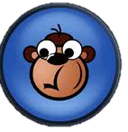
ADVERTISING MY FILM
In the process of making my film I wanted to find out what my audience would prefer to see in horror movies.
To do this I used the program called survey monkey. This program enables you to allow the public to take an online survey that you have made up. This was very helpful as I was able to see what my target audience want to be watching.
The program was easy to navigate around but one problem I had at the beginning was selecting a new question. I couldn’t see where you clicked to add a new question. Other than that I found survey monkey easy to use. A good thing about it is it shows your results clearly. This helped me when writing up my evaluation for it.
A program that I used to advertise my film and also my survey was Facebook. As I am familiar with this program I had no troubles. I found it very interesting what people thought about horror and Yurei horror films.

